Slide 1
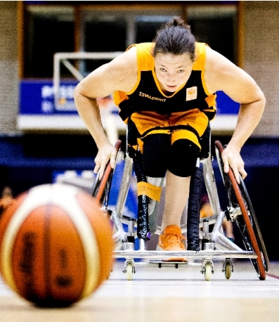

Project wheels
Notes:
Good morning everyone we are the team for the project wheels

Slide 2

Introduction
Martijn (electrical eng.)
Jake (software eng.)
Sjoerd (software eng.)
Collin (electrical eng.)
Alex (informatic/software eng.)
Daan (human movement tech.)

Slide 3
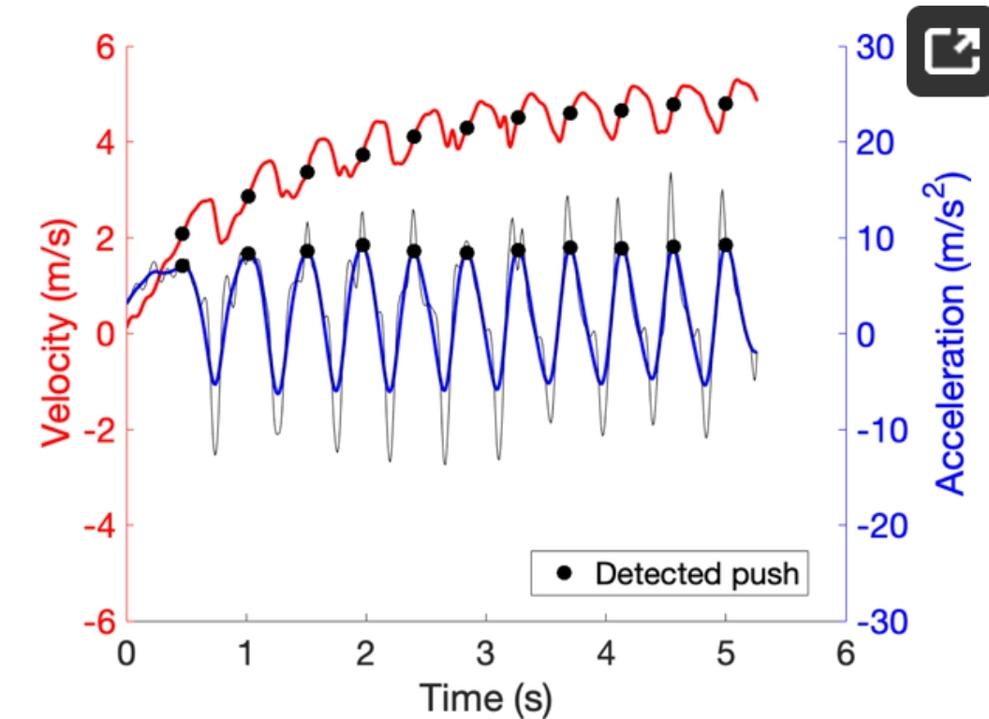
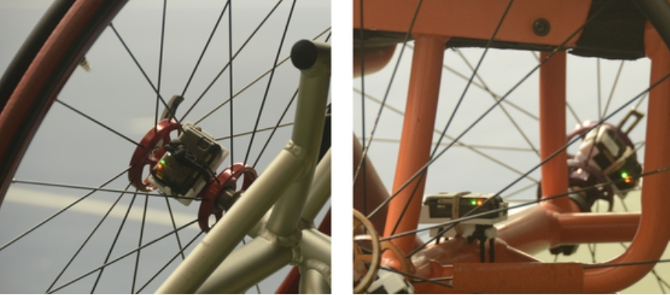
Project
Introduction
Problem description
Notes:
During this project we will focus on the Paralympic sport Wheelchair basketball. During both training and matches some players have IMU’s on their wheelchair. An IMU (internal measurement unit) consists of combination of accelerometers & gyroscopes. These measure the acceleration and rotations of the sensor. This data can be used to calculate speed and movement. During this project we will use the RAW data of the IMU’s. To detect collisions and how much effort a training or match is. With this data we can prevent overload on the players so that there will be less injuries.

Slide 4
What are we going to do
This week we already got some meetings planned.
Getting a closer look at the data
Getting ideas for a game plan
Notes:
Looking forward we will have a few meetings this week. We will analyse the data. And we will start writing our plan of approach.

